Slide 1
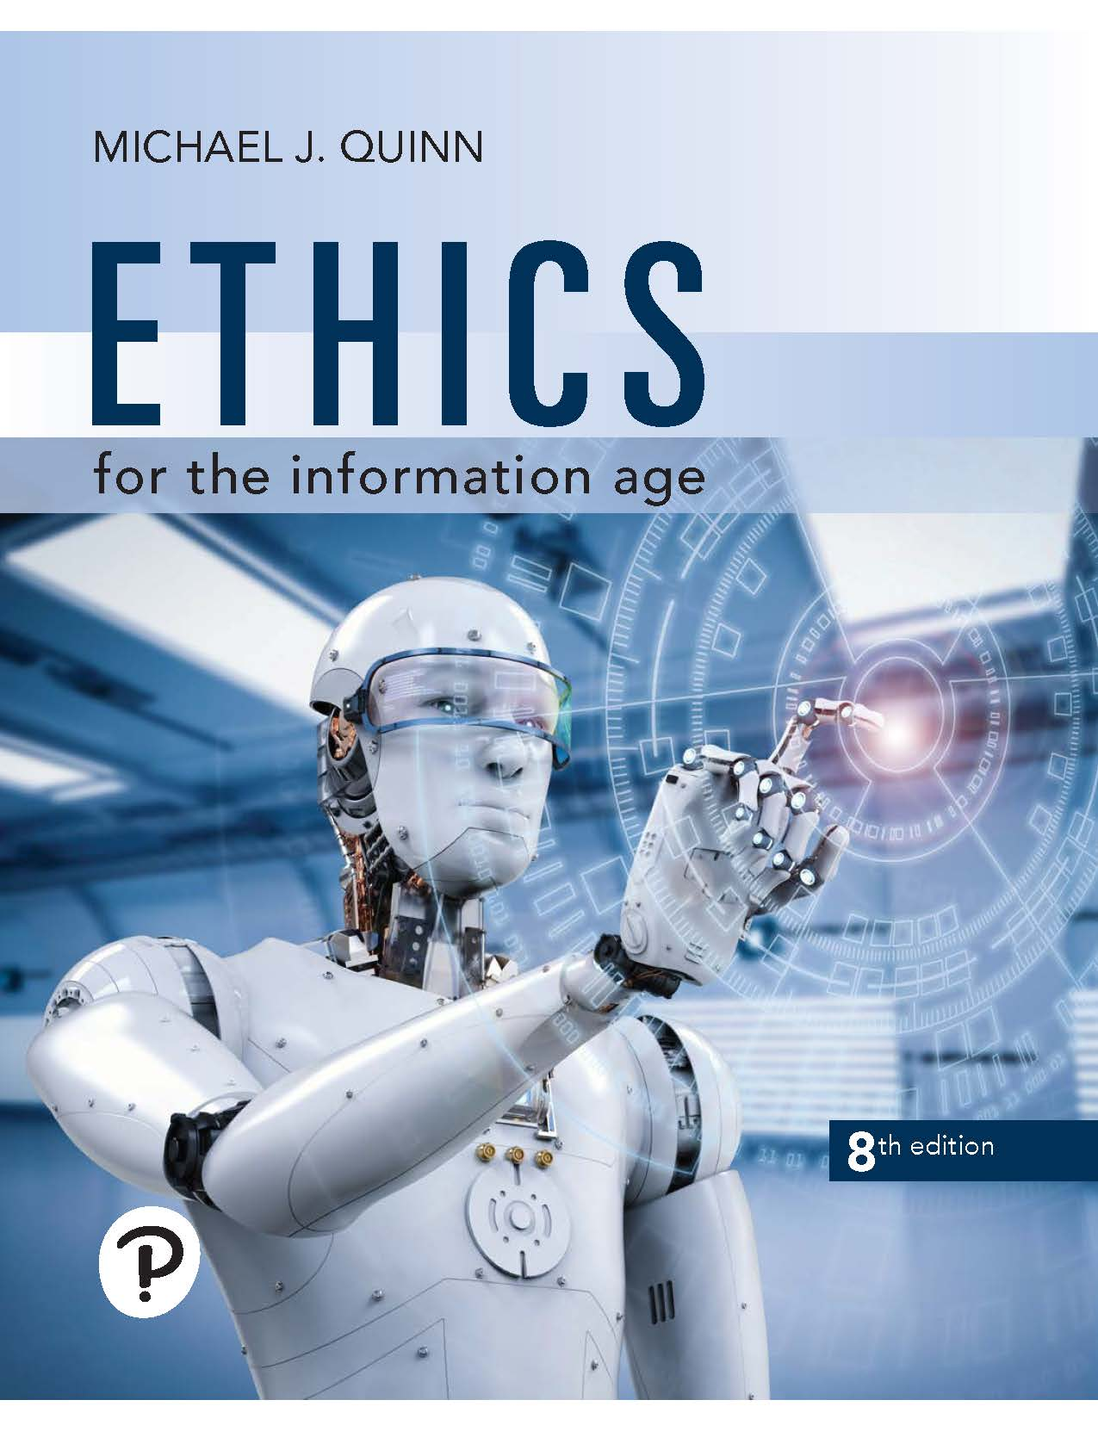
Ethics for the Information Age
Eighth Edition
Chapter 7
Computer and Network Security
Copyright © 2020, 2017, 2015 Pearson Education, Inc. All Rights Reserved
Notes:
If this PowerPoint presentation contains mathematical equations, you may need to check that your computer has the following installed:
1) MathType Plugin
2) Math Player (free versions available)
3) NVDA Reader (free versions available)

Slide 2
Learning Objectives
7.1 Introduction
7.2 Hacking
7.3 Malware
7.4 Cyber crime and cyber attacks
7.5 Online voting

Slide 3
7.1 Introduction

Slide 4
7.1 Introduction
Increasing use of computers → growing importance of computer security
Harmful consequences of lack of security
Stolen information
Extortion
Computers and networks can be weaponized, allowing attacks on cyber infrastructure of governments and organizations

Slide 5
7.2 Hacking

Slide 6
Hackers, Past and Present
Original meaning of hacker: explorer, risk taker, system innovator
M I T’s Tech Model Railroad Club in 1950s
1960s-1980s: Focus shifted from electronics to computers and networks
1983 movie WarGames
Modern meaning of hacker: someone who gains unauthorized access to computers and computer networks

Slide 7
Obtaining Login Names, Passwords
Eavesdropping
Dumpster diving
Social engineering
Brute-force searches
Dictionary attacks

Slide 8
Password Dos and Don’ts
Do not use short passwords.
Do not rely solely on words from the dictionary.
Do not rely on substituting numbers for letters.
Do not reuse passwords.
Give ridiculous answers to security questions.
Enable two-factor authentication if available.
Have password recoveries sent to a secure email address.

Slide 9
Computer Fraud and Abuse Act
Criminalizes wide variety of hacker-related activities
Transmitting code that damages a computer
Accessing any Internet-connected computer without authorization
Transmitting classified government information
Trafficking in computer passwords
Computer fraud
Computer extortion
Maximum penalty: 20 years in prison and $250,000 fine

Slide 10
Electronic Communications Privacy Act
Illegal to intercept …
Telephone conversations
Email
Any other data transmission
Crime to access stored email messages without authorization

Slide 11
F B I and the Locked iPhone (1 of 3)
December 2015
Syed Rizwan Farook and Tashfeen Malik killed 14, wounded 22 others at holiday gathering in San Bernardino, California
Malik pledged allegiance to the Islamic State
Farook and Malik died in shootout with police
F B I recovered Malik’s work-issued iPhone 5C, but it was locked
Built-in security features of iPhone 5C
All personal data encrypted
After 10 consecutive incorrect passcode entry attempts, encryption key deleted, rendering all personal data inaccessible
When incorrect passcodes are entered, delay introduced between passcode entry attempts

Slide 12
F B I and the Locked iPhone (2 of 3)
February 2016
F B I asked Apple to create a new version of i O S that disabled the passcode security features
Apple refused to cooperate
F B I convinced a U S magistrate to issue an order for Apple to comply
Apple’s argument
If “backdoor” version of i O S that disabled security features fell into wrong hands, criminals would be able to unlock any iPhone
All iPhone users would be harmed

Slide 13
F B I and the Locked iPhone (3 of 3)
Department of Justice’s argument
Apple could maintain custody of software
Apple could destroy software after being used by F B I
March 2016
Department of Justice withdrew request, declared it had gotten into locked iPhone
Inspector General of D o J later determined F B I had made request of Apple before exploring whether F B I had means to unlock iPhone
Skeptics claimed F B I more interested in getting legal precedent than gaining access to Farook’s data

Slide 14
Sidejacking
Sidejacking: hijacking of an open Web session by capturing a user’s cookie
Sidejacking possible on unencrypted wireless networks because many sites send cookies “in the clear”
Internet security community complained about sidejacking vulnerability for years, but ecommerce sites did not change practices

Slide 15
Case Study: Firesheep
October 2010: Eric Butler released Firesheep extension to Firefox browser
Firesheep made it possible for ordinary computer users to easily sidejack Web sessions
More than 500,000 downloads in first week
Attracted great deal of media attention
Early 2011: Facebook and Twitter announced options to use their sites securely

Slide 16
Act Utilitarian Analysis
Release of Firesheep led media to focus on security problem
Benefits were high: a few months later Facebook and Twitter made their sites more secure
Harms were minimal: no evidence that release of Firesheep caused big increase in identity theft or malicious pranks
Conclusion: Release of Firesheep was good

Slide 17
Virtue Ethics Analysis
By releasing Firesheep, Butler helped public understand lack of security on unencrypted wireless networks
Butler’s statements characteristic of someone interested in protecting privacy
Butler demonstrated courage by taking responsibility for the program
Butler demonstrated benevolence by making program freely available
His actions and statements were characteristic of someone interested in the public good

Slide 18
Kantian Analysis (1 of 2)
Accessing someone else’s user account is an invasion of their privacy and is wrong
Butler provided a tool that made it much simpler for people to do something that is wrong, so he has some moral accountability for their misdeeds
Butler was willing to tolerate short-term increase in privacy violations in hope that media pressure would force Web retailers to add security
He treated victims of Firesheep as a means to his end
It was wrong for Butler to release Firesheep

Slide 19
7.3 Malware

Slide 20
Viruses
Virus: Piece of self-replicating code embedded within another program (host)
Viruses associated with program files
Hard disks, floppy disks, C D-R O M S
Email attachments
How viruses spread
Diskettes or C Ds
Email
Files downloaded from Internet

Slide 21
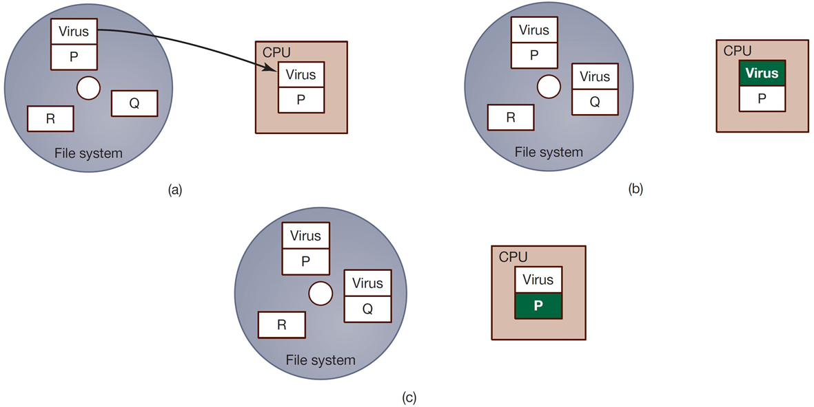
One Way a Virus Can Replicate
(a) A computer user executes program P, which is infected with a virus. (b) The virus code begins to execute. It finds another executable program Q and creates a new version of Q infected with the virus. (c) The virus passes control to program P. The user, who expected program P to execute, suspects nothing

Slide 22
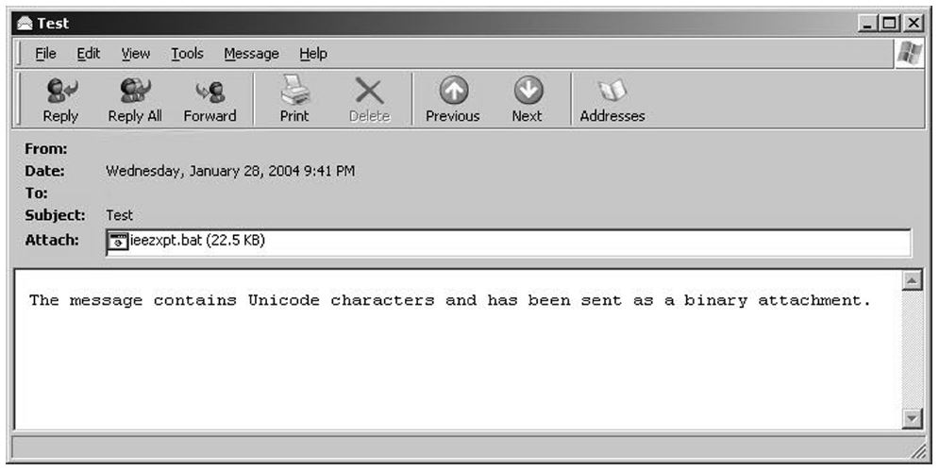
Email Attachment with Possible Virus

Slide 23
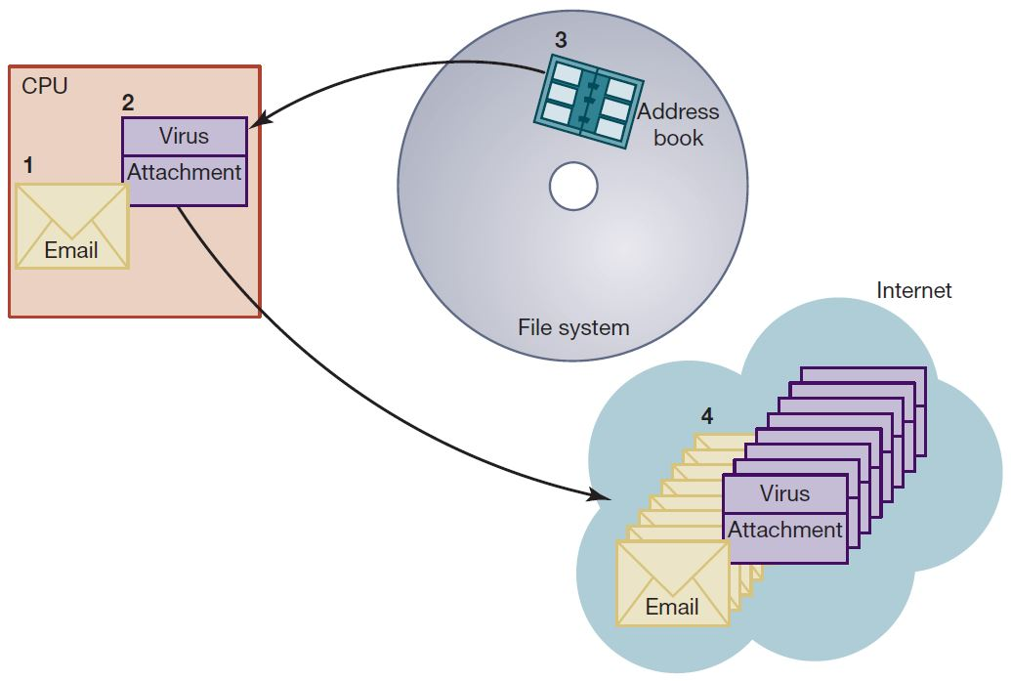
How an Email Virus Spreads
A computer user reads an email with an attachment (1). The user opens the attachment, which contains a virus (2). The virus reads the user’s email address book (3). The virus sends emails with virus-containing attachments (4).

Slide 24
Antivirus Software Packages
Allow computer users to detect and destroy viruses
Must be kept up-to-date to be most effective
Many people do not keep their antivirus software packages up-to-date
Consumers need to beware of fake antivirus applications

Slide 25
Worm
Self-contained program
Spreads through a computer network
Exploits security holes in networked computers

Slide 26
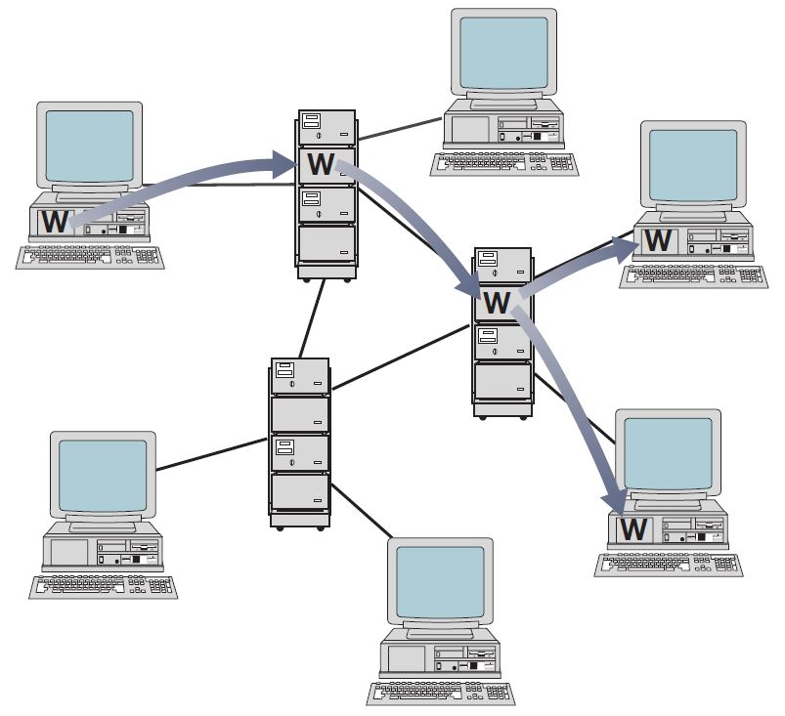
Worm Propagation
A worm spreads to other computers by exploiting security holes in computer networks.

Slide 27
The Internet Worm
Robert Tappan Morris, Jr.
Graduate student at Cornell
Released worm onto Internet from M I T computer
Effect of worm
Spread to significant numbers of Unix computers
Infected computers kept crashing or became unresponsive
Took a day for fixes to be published
Impact on Morris
Suspended from Cornell
3 years’ probation + 400 hours community service
$150,000 in legal fees and fines

Slide 28
Ethical Evaluation (1 of 2)
Kantian evaluation
Morris used others by gaining access to their computers without permission
Social contract theory evaluation
Morris violated property rights of organizations
Utilitarian evaluation
Benefits: Organizations learned of security flaws
Harms: Time spent by those fighting worm, unavailable computers, disrupted network traffic, Morris’s punishments

Slide 29
Ethical Evaluation (2 of 2)
Virtue ethics evaluation
Morris selfishly used Internet as experimental lab
He deceitfully released worm from M I T instead of Cornell
He avoided taking responsibility for his actions
Morris was wrong to have released the Internet worm

Slide 30
Sasser Worm
Launched in April 2004, infected 18 million computers
Disrupted operations at Delta Airlines, European Commission, Australian railroads, British coast guard
German juvenile Sven Jaschan confessed to crime
Sentenced to 30 hours of community service and 18 months’ probation

Slide 31
Instant Messaging Worms
Choke and Hello (2001)
Kelvir (2005)
Reuters had to remove 60,000 subscribers from its instant messaging service
Palevo (2010)
Spread through Romania, Mongolia, Indonesia

Slide 32
Conficker Worm
Conficker (a.k.a. Downadup) worm appeared 2008 on Windows computers
Millions of copies of worm are circulating among computers running older software without appropriate security patches
Often legacy systems in factories or health-care facilities
Purpose of worm seems to be simply to propagate

Slide 33
Cross-Site Scripting
Another way malware may be downloaded without user’s knowledge
Problem appears on Web sites that allow people to read what others have posted
Attacker injects client-side script into a Web site
Victim’s browser executes script, which may steal cookies, track user’s activity, or perform another malicious action

Slide 34
Drive-By Downloads
Unintentional downloading of malware caused by visiting a compromised Web site
Also happens when Web surfer sees pop-up window asking permission to download software and clicks “Okay”
Google Anti-Malware Team says 1.3 percent of queries to Google’s search engine return a malicious U R L somewhere on results page

Slide 35
Trojan Horses and Backdoor Trojans
Trojan horse: Program with benign capability that masks a sinister purpose
Backdoor Trojan: Trojan horse that gives attack access to victim’s computer

Slide 36
Ransomware
Definition: Malware designed to extort money from victim
How installed
Drive-by download
Trojan Horse
Email attachment
Other means
Early versions accused victims of illegal activities, demanded “fines”
Modern versions encrypt all files on victim’s computer and demand payment in return for decryption key

Slide 37
Rootkits
Rootkit: A set of programs that provides privileged access to a computer
Activated every time computer is booted
Uses security privileges to mask its presence

Slide 38
Spyware and Adware
Spyware: Program that communicates over an Internet connection without user’s knowledge or consent
Monitor Web surfing
Log keystrokes
Take snapshots of computer screen
Send reports back to host computer
Adware: Type of spyware that displays pop-up advertisements related to user’s activity
Backdoor Trojans often used to deliver spyware and adware

Slide 39
Bots
Bot: A kind of backdoor Trojan that responds to commands sent by a command-and-control program on another computer
First bots supported legitimate activities
Internet Relay Chat
Multiplayer Internet games
Other bots support illegal activities
Distributing spam
Collecting person information for I D theft
Denial-of-service attacks

Slide 40
Bots and Botnets
Bot: Type of backdoor Trojan that responds to commands from a command-and-control program on another computer
Botnet: Collection of bot-infected computers controlled by the same command-and-control program
Some botnets have over a million computers in them
Bot herder: Someone who controls a botnet
Uses of botnets
Distribute spam
Launch distributed denial-of-service attacks

Slide 41
Protecting Your Internet-Connected Devices
Make sure you’ve installed latest security patches.
Install anti-malware tools on your computer.
Before buying an Internet-connected device, see if manufacturer is taking reasonable security precautions.
Immediately change the default password of devices you connect to the Internet.
Choose a different password for each of your devices.
Consider replacing insecure Internet-of-Things devices.

Slide 42
Security Risks of “Bring Your Own Device”
87% of U S companies rely on employees accessing mobile business aps from their personal smartphones
Benefits of “Bring Your Own Device”
Employers reduce hardware, software expenditures
Increased productivity and job satisfaction of employees
Potential harms of “Bring Your Own Device”
Company data may be compromised if device stolen
Insecure device can make company vulnerable to data breach

Slide 43
“Bring Your Own Device” Policy Questions
What are the security standards for personal devices (password requirements, anti-malware packages, etc.)?
What applications can employees run from their devices?
What level of support will company’s I T department provide?
Does the company have right to erase all data from a personal device that has been stolen?
When employees leave company, how will company data be removed from their devices?

Slide 44
7.4 Cyber Crime and Cyber Attacks

Slide 45
Phishing and Spear-Phishing
Phishing: Large-scale effort to gain sensitive information from gullible computer users
At least 124,000 phishing attacks globally in second half of 2014
New development: phishing attacks on Chinese e-commerce sites
Spear-phishing: Variant of phishing in which email addresses chosen selectively to target particular group of recipients

Slide 46
S Q L Injection
Method of attacking a database-driven Web application with improper security
Attack inserts (injects) S Q L query into text string from client to application
Application returns sensitive information

Slide 47
Denial-of-Service and Distributed Denial-of-Service Attacks
Denial-of-service attack: Intentional action designed to prevent legitimate users from making use of a computer service
Aim of a D o S attack is not to steal information but to disrupt a server’s ability to respond to its clients
Distributed denial-of-service attack: D o S attack launched from many computers, such as a botnet

Slide 48
Internet-of-Things Devices Co-opted for D D o S Attack
D D o S attack of October 21, 2016 on domain name service provider Dyn
Netflix, Twitter, Spotify, Reddit, PayPal, Pinterest, C N N, Fox News, the Guardian, the New York Times, the Wall Street Journal unreachable for several hours
Attack launched by Mirai botnet, perhaps 100,000 devices
Network routers
Security cameras
Baby monitors
I o T devices easy to co-opt
Many people never change default passwords
Some devices have no password protection

Slide 49
Cyber Crime
Criminal organizations making significant amounts of money from malware
Jeanson James Ancheta
Pharmamaster
Albert Gonzalez
Avalanche Gang

Slide 50
The Rise and Fall of Blue Security Part : The Rise
Blue Security: An Israeli company selling a spam deterrence system
Blue Frog bot would automatically respond to each spam message with an opt-out message
Spammers started receiving hundreds of thousands of opt-out messages, disrupting their operations
6 of 10 of world’s top spammers agreed to stop sending spam to users of Blue Frog

Slide 51
The Rise and Fall of Blue Security Part The Fall
One spammer (PharmaMaster) started sending Blue Frog users 10-20 times more spam
PharmaMaster then launched D D o S attacks on Blue Security and its business customers
Blue Security could not protect its customers from D D o S attacks and virus-laced emails
Blue Security reluctantly terminated its anti-spam activities

Slide 52
Politically Motivated Cyber Attacks
Estonia (2007)
Georgia (2008, 2009)
Exiled Tibetan Government (2009)
United States and South Korea (2009)
Iran (2009)
Espionage attributed to People’s Liberation Army
Anonymous

Slide 53
Attacks on Twitter and Other Social Networking Sites
Massive D D o S attack made Twitter service unavailable for several hours on August 6, 2009
Three other sites attacked at same time: Facebook, LiveJournal, and Google
All sites used by a political blogger from the Republic of Georgia
Attacks occurred on first anniversary of war between Georgia and Russia over South Ossetia

Slide 54
Fourth of July Attacks
4th of July weekend in 2009: D D o S attack on governmental agencies and commercial Web sites in United States and South Korea
Attack may have been launched by North Korea in retaliation for United Nations sanctions

Slide 55
Supervisory Control and Data Acquisition (S C A D A) Systems
Industrial processes require constant monitoring
Computers allow automation and centralization of monitoring
Today, S C A D A systems are open systems based on Internet Protocol
Less expensive than proprietary systems
Easier to maintain than proprietary systems
Allow remote diagnostics
Allowing remote diagnostics creates security risk

Slide 56
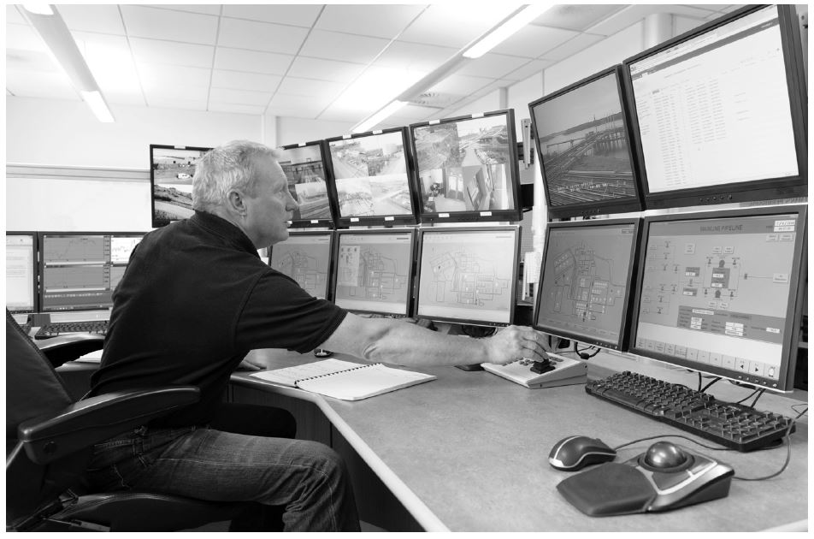
S C A D A Systems Carry Security Risks
Internet-based supervisory control and data acquisition (S C A D A) systems can save money and make systems easier to administer, but they also carry security risks. (Dave and Les Jacobs/Kolostock/Blend Images)

Slide 57
Stuxnet Worm (2009)
Attacked S C A D A systems running Siemens software
Targeted five industrial facilities in Iran that were using centrifuges to enrich uranium
Caused temporary shutdown of Iran’s nuclear program
United States and Israel cooperated to develop and launch the worm

Slide 58
Cyber Espionage Attributed to People’s Liberation Army
Hundreds of computer security breaches over a decade in more than a dozen countries investigated by Mandiant
Hundreds of terabytes of data stolen
Mandiant blamed Unit 61398 of the People’s Liberation Army
China’s foreign ministry stated that accusation was groundless and irresponsible
U S government disclosed in 2015 that S S Ns and other personal information from 22 million Americans stolen from Office of Personnel Management computers
Prime suspect: Unit 61398 of People’s Liberation Army

Slide 59
Anonymous
Anonymous: loosely organized international movement of hacktivists (hackers with a social or political cause)
Various D D o S attacks attributed to Anonymous members

Slide 60
Actions Attributed to Anonymous
Year | Victim | Reason
2008 | Church of Scientology | Attempted suppression of Tom Cruise interview
2009 | R I A A, M P A A | R I A A, M P A A’s attempt to take down the Pirate Bay
2009 | PayPal, V I S A, MasterCard | Financial organizations freezing funds flowing to Julian Assange of WikiLeaks
2012 | U.S. Dept. of Justice, R I A A, M P A A | U.S. Dept. of Justice action against Megaupload
2013 | Israel | Protest Israeli treatment of Palestinians
2014 | City of Cleveland | Protest killing of 12-year-old Tamir Rice by a Cleveland police officer
2015 | Jihadist groups | Terrorist attack on Paris office of Charlie Hebdo magazine

Slide 61
Convictions of Anonymous Members
Dozens of people around the world have been arrested for participation in Anonymous cyber attacks
Dmitriy Guzner (Church of Scientology attacks): 366 days in prison and $37,500 in restitution
Brian Mettenbrink (Church of Scientology attacks): 1 year in prison and $20,000 in restitution
Jake Davis (Sony Pictures attacks): 2 years in prison

Slide 62
7.5 Online Voting

Slide 63
Motivation for Online Voting
2000 U.S. Presidential election closely contested
Florida pivotal state
Most Florida counties used keypunch voting machines
Two voting irregularities traced to these machines
Hanging chad
“Butterfly ballot” in Palm Beach County

Slide 64
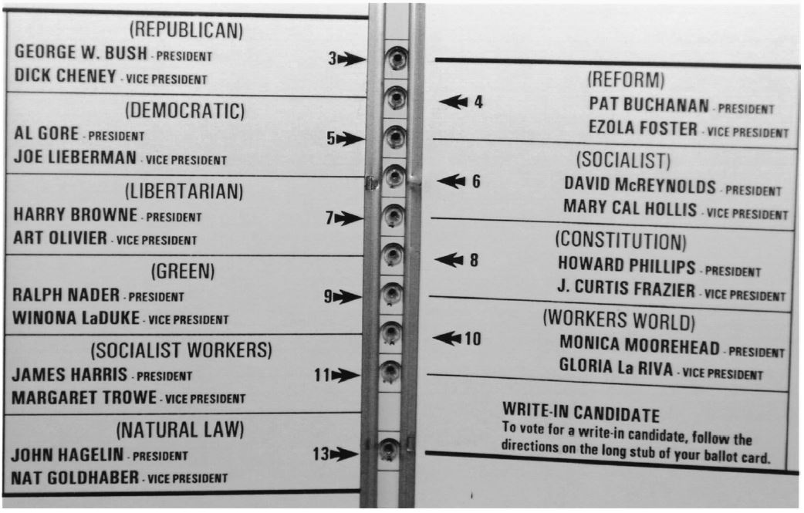
The Infamous “Butterfly Ballot”
The layout of the “butterfly ballot” apparently led thousands of Palm Beach County, Florida, voters supporting candidate Al Gore to punch the hole associated with Pat Buchanan by mistake. (A P Photo/Gary I. Rothstein)

Slide 65
Benefits of Online Voting
More people would vote
Votes would be counted more quickly
No ambiguity with electronic votes
Cost less money
Eliminate ballot box tampering
Software can prevent accidental over-voting
Software can prevent under-voting

Slide 66
Risks of Online Voting
Gives unfair advantage to those with home computers
More difficult to preserve voter privacy
More opportunities for vote selling
Obvious target for a D D o S attack
Security of election depends on security of home computers
Susceptible to vote-changing virus or remote access Trojan
Susceptible to phony vote servers
No paper copies of ballots for auditing or recounts

Slide 67
Utilitarian Analysis
Suppose online voting replaced traditional voting
Benefit: Time savings
Assume 50% of adults actually vote
Suppose voter saves 1 hour by voting online
Average pay in U.S. is $21.00/hour
Time savings worth $10.50 per adult American
Harm of D D o S attack difficult to determine
What is probability of a D D o S attack?
What is the probability an attack would succeed?
What is the probability a successful attack would change the outcome of the election?

Slide 68
Kantian Analysis (2 of 2)
The will of each voter should be reflected in that voter’s ballot
The integrity of each ballot is paramount
Ability to do a recount necessary to guarantee integrity of each ballot
There should be a paper record of every vote
Eliminating paper records to save time and/or money is wrong

Slide 69
Conclusions
Existing systems are highly localized
Widespread tainting more possible with online system
No paper records with online system
Evidence of tampering with online elections
Relying on security of home computers means system vulnerable to fraud
All in all, strong case for not allowing online voting

Slide 70
Summary
We all have something to lose if computer systems are insecure
Security often a trade-off between safety and convenience
Many ways for personal computers to become infected with malware
New twist: malware infecting Internet-of-Things devices
Cyber attacks becoming more common – at what point does a cyber attack become an act of war?

Slide 71

Copyright
This work is protected by United States copyright laws and is provided solely for the use of instructors in teaching their courses and assessing student learning. Dissemination or sale of any part of this work (including on the World Wide Web) will destroy the integrity of the work and is not permitted. The work and materials from it should never be made available to students except by instructors using the accompanying text in their classes. All recipients of this work are expected to abide by these restrictions and to honor the intended pedagogical purposes and the needs of other instructors who rely on these materials.

